Slide 1
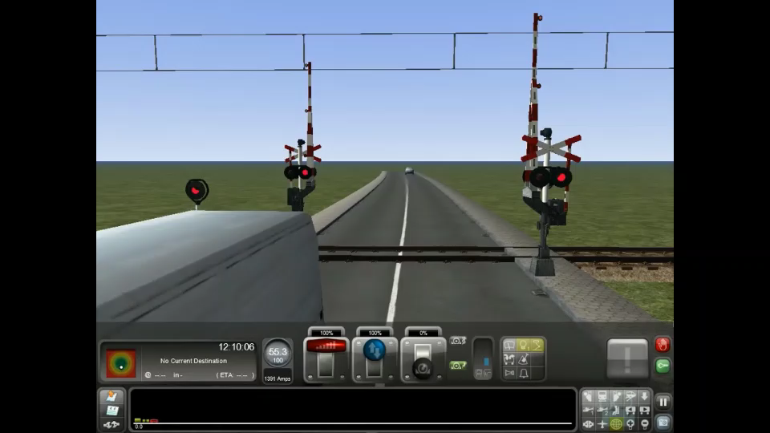
Railway level crossings
Keep your distance at any level crossing
Do NOT cross a railway once the red lights have started to flash
At crossings without gates: always stop, look both ways, listen carefully if there is no train coming
If you are just crossing when the red lights start flashing: keep going

